Slide 1

Ontology-based Expert System for a Generic Drug Production of Pharmaceutical Dosage Forms
Progress 1
Wednesday, July 16, 2014
By
Mr. Narongrit Saisuwan 542115017
Mr. Panupak Wichaidit 542115047
Notes:
Introduce your self

Slide 2
Over View
Ontology-based Expert System for a Generic Drug Production of Pharmaceutical Dosage Forms
Original Drug
Don’t know manufacturing
Don’t know excipients
Reformulate
Find manufacturing similar with an original drug
Find excipients similar with an original drug.
Generic Drug
Manufacturing and excipient similar with Original
The result and Dissolution profile similar with Original Drug
Know the result and Dissolution profile
Compare a result and Dissolution profile with the original drug
Produce It!!
Notes:
Our project is the expert system that help the pharmacists who try to reformulate a original drug as a generic version.
The process of reformulation is shown on the slide. Firstly, the pharmacist knows the excipient and the result but they don’t know manufacturing.
Next, the reformulation process can help the pharmacists to find a manufacturing of each drug. Then produce it as generic and got generic drug at the last process.
But, at the reformulation step, the pharmacists use a lot of time to find appropriate manufacturing. For solve this problem, we develop the expert system for helping them to making reformulation

Slide 3
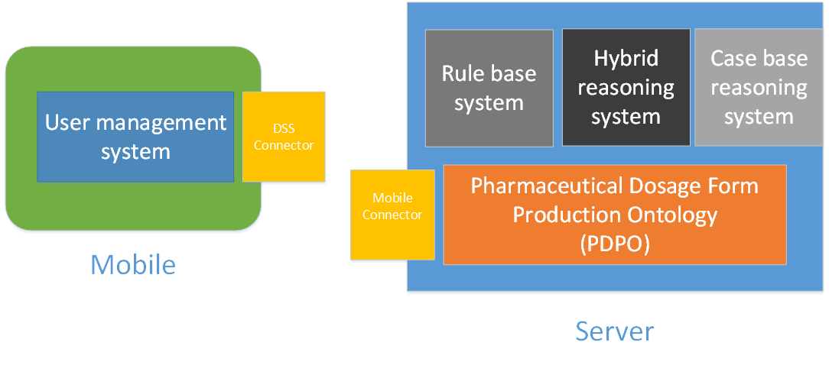
System Architecture overview

Slide 4
Feature in the Progress 1
Feature 5 : Pharmaceutical Dosage Form Production Ontology(PDPO)
Substance Property
Substance
Excipient
Tablet Formulation
Sub-Feature
Manage the Substance Property
Manage the Substance
Manage the Excipient
Mange the Tablet Formulation

Slide 5
Feature in the progress 1
Use Case Diagram(page 5 in a software requirement)

Slide 6
Sub-Feature 5 : Manage the substance property
Substance properties
Solubility
Degradation Mechanism
Kinetic Reaction
Pka
Partition Coefficient
Solid-state
Hygroscopicity
Particle Size
Flowability
Density
CompoundFunction

Slide 7
Sub-Feature: Manage the substance property
User requirement specification
URS 09 : The user adds a new substance property into the system.
SRS 66 : The system provides the Graphic user interface (GUI) which receive substance property such as Solubility, Degradation Mechanism, Kinetic Reaction, Pka, Partition Coefficient Property, Solid state, Hygroscopicity, Particle Property, Flow ability Property, Density, Salt Property, Compound Function.
SRS 67 : The system can check the solubility type format. The solubility type format should be the characters.
SRS 68 : The system can check the solubility maximum format. The solubility maximum format should be the float number.
SRS 69 : The system can check the solubility minimal format. The solubility minimal format should be the float number.
SRS 70 : The system can check the solubility value format. The solubility value format should be the float number.

Slide 8
Sub-Feature: Manage the substance property
User requirement specification
URS 09 : The user adds a new substance property into the system.
SRS-90 : The system save the substance property to the system.
SRS-91 : The system shall show the successful add a new substance property page.
SRS 92 : The system shall display the error message “The solubility type should be the characters.”
SRS 93 : The system shall display the error message “The solubility maximum should be the float number.”
SRS 94 : The system shall display the error message “The solubility minimal should be the float number.”
SRS 95 : The system shall display the error message “The solubility value should be the float number.”

Slide 9
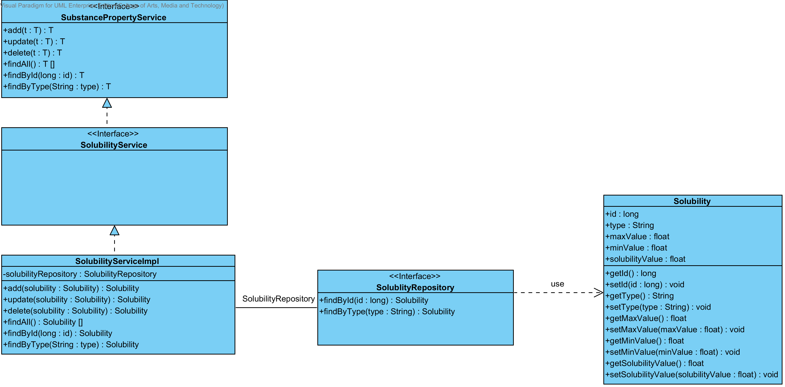
URS 09 : The user adds a new substance property into the system.
Class Diagram

Slide 10
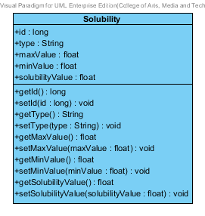
URS 09 : The user adds a new substance property into the system.
Solubility
It is entity class
Notes:
The solubility class. The solubility class is a entity class. There are getter and setter method, For set and get method from the user.

Slide 11
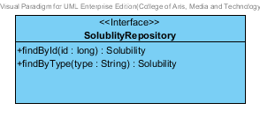
URS 09 : The user adds a new substance property into the system.
SolubilityRepository
This class is used. When the user wants to manage the solubility
Its generated from Spring data MongoDB framework.
Notes:
The Solubility Repository Class. The class that connect to the data base. Its used for solubility management. The most of the method such as add, update and delete

Slide 12
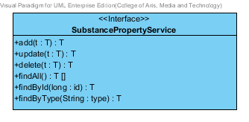
URS 09 : The user adds a new substance property into the system.
SubstancePropertyService
It is generic interface
Its used in every substance property class
Notes:
The substance property service is generic method that parameterized over the type. The type is the substance property object that the user input to the class. For the example, the user input the solubility object as parameter to the class. This class will make method add ,update and delete for support the solubility object.

Slide 13
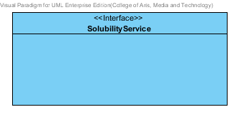
URS 09 : The user adds a new substance property into the system.
SolubilityService
It is business processing logic for solubility entity.
It manage the solubility by solubility repository.
Notes:
The solubility service is business processing logic for solubility entity. The solubility service is extend the method from the substance property service such as add, update and delete method. It manages the solubility entity using the method from the solubility repository.

Slide 14
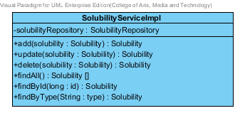
URS 09 : The user adds a new substance property into the system.
SolubilityServiceImpl
It is business processing logic for solubility entity.
It manage the solubility by solubility repository.
Notes:
Same as

Slide 15
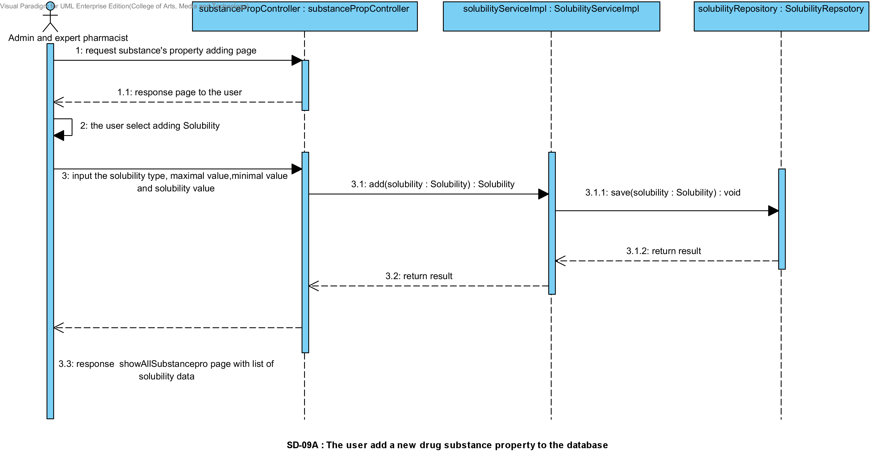
URS 09 : The user adds a new substance property into the system.
Sequence diagram :

Slide 16
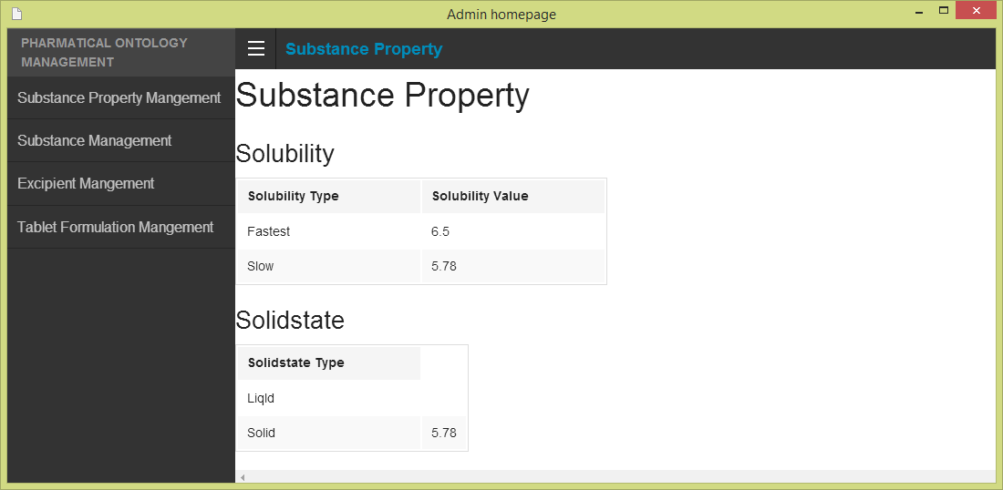
URS 09 : The user adds a new substance property into the system.
User Interface Design

Slide 17
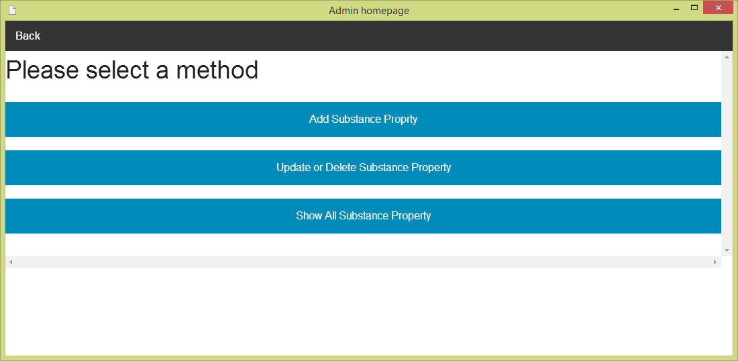
URS 09 : The user adds a new substance property into the system.
User Interface Design

Slide 18
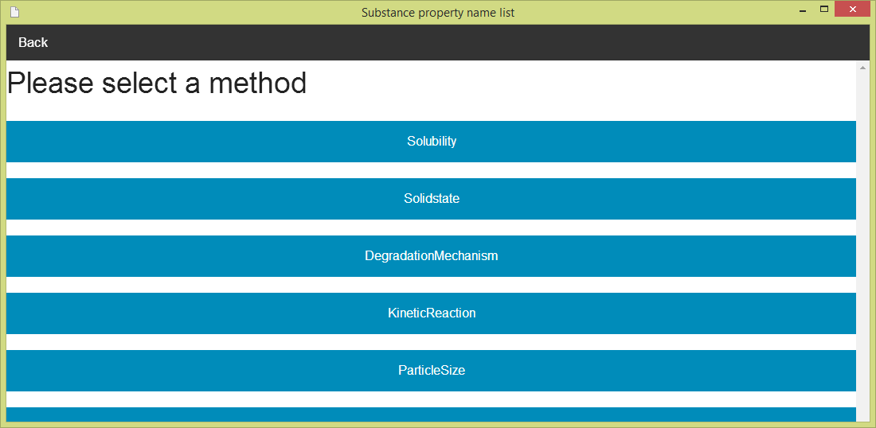
URS 09 : The user adds a new substance property into the system.
User Interface Design

Slide 19
URS 09 : The user adds a new substance property into the system.
User Interface Design

Slide 20
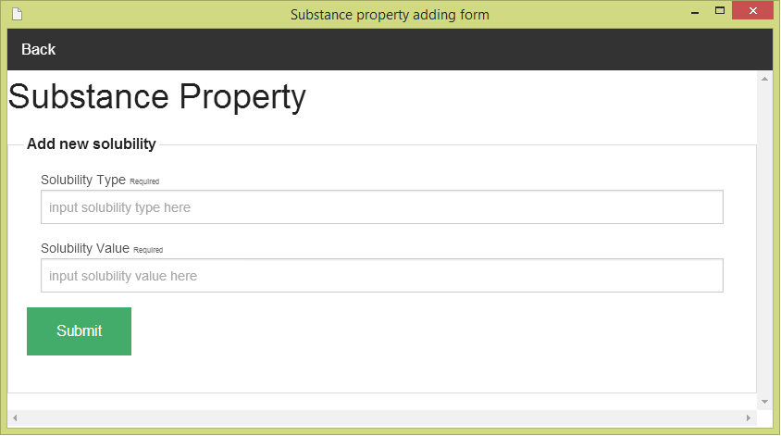
URS 09 : The user adds a new substance property into the system.
User Interface Design

Slide 21
URS 09 : The user adds a new substance property into the system.
Unit Test
Test only the Service Class
Not test the Repository Class, because the method in a class is generated from Spring data MongoDB framework.
Unit Test Case is adding a new substance property(solublity)

Slide 22
URS 09 : The user adds a new substance property into the system.
Unit Test Case : add(Solubility solubility): Solubility
Test data
Object Name | ID | Type | MaxValue | MinValue | SolubilityValue
Solubility1 | 1 | “solubility1” | 4 | 2 | 5
Solubility2 | 2 | “solubility2” | 7 | 1 | 3

Slide 23
URS 09 : The user adds a new substance property into the system.
Unit Test Case: add(Solubility solubility): Solubility
Test case
Case No. | Description | Input data | Expect Result
1 | Test add solubility object which is correct the formal of solubility object. | Solubility3 | Solubility3
2 | Test add solubility object which is correct the formal of solubility object. | Solubility4 | Solubility4
3 | Test add solubility object which is contained in the database already. | Soluility1 | Null
4 | Test add solubility object which is contained in the database already. | Solubility2 | Null

Slide 24
Testing

Slide 25
URS 09 : The user adds a new substance property into the system.
Unit Test Case : add(Solubility solubility): Solubility
Test Record
Case No. | Description | Expect Result | Actual Result
1 | Test add solubility object which is correct the formal of solubility object. | Solubility3 | Solubility3
2 | Test add solubility object which is correct the formal of solubility object. | Solubility4 | Solubility4
3 | Test add solubility object which is contained in the database already. | Null | Null
4 | Test add solubility object which is contained in the database already. | Null | Null

Slide 26
Problem
Rule Base System is not finish at the progress 1

Slide 27
Solve the problem

Slide 28
Thank you!
Q&A

